Slide 1
Application Delivery Fundamentals: Java
Module 2: Introduction to Java

Slide 2

Module Objective
At the end of this module, you will be able to:
Describe the primary concepts that support Java technology
Explain how Java achieves platform independence
Discuss the different tools and libraries available as part of the Standard Java Development KIT (J2SE JDK)
Install and configure the required software, tools, and libraries to get started with Java
Write, compile, and execute simple Java applications
2

Slide 3
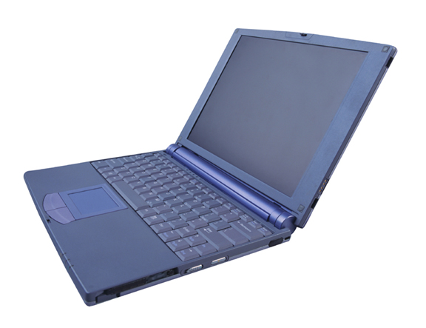
Brief History of Java
3
Java was originally called “Oak”
Java was meant to be a programming language specifically for appliances and various small devices
The original specification:
Targeted set-top boxes for cable television that allowed users a control and interactivity when using the service
Java specification is owned by Sun Microsystems
The newly emerging Internet proved to be a much better platform for the specification:
The way the Net was being used had the same interactivity they planned for cable television customers
Notes:
Key message:
Java was one of the first technologies that allowed the then-static web pages interactivity. Their specific demonstration was a web-page that displayed a 3D molecule being rotated by movements by a mouse cursor. At the time, that was an amazing feat since web-pages at the time were little more than links, text and images

Slide 4
The Java Programming Language
Portable
The Java language and libraries are platform-independent.
Java has a sophisticated set of synchronization primitives that are based on the widely used monitor and condition variable paradigm.
Multi-Threaded
Robust
Programmers don’t have to worry about freeing or corrupting memory.
4
The Java programming language is a fully object-oriented language.
The standard edition provides pre-built libraries and APIs that provide useful capabilities out of the box.
Java is:
Notes:
Key message:
Explain that Java is an entire platform, not just a programming language.
The Java programming language is a fully object-oriented language.
An Object-Oriented language is built around the concept of an object as a software entity. We will study and understand concept of object and classes in Module 5 in more detail.

Slide 5
The Java Technology Platform
5
Java applications run on a virtual machine environment that:
Isolates the underlying platform
Achieves portability and performance
Provides security
Java source code is written as plain text files (.java) that are compiled as platform independent byte-codes (.class)
Java byte-codes are interpreted and executed by the virtual machine that passes the instructions to the actual platform
Notes:
Key message:
The virtual machine provides a standardized environment for byte-codes to execute. By isolating and hiding the underlying hardware platform, Java programmers will not have worry about the specifics of their target platform when writing code. All compliant virtual machines are capable of reading byte-codes. Byte codes can be executed from one VM to another without a need to re-compile.

Slide 6
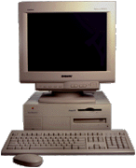
The Java Technology Platform
JVM
(Win32)
Java Source File
(.java)
Java Byte-Code
(.class)
Java Compiler
JVM
(Solaris)
JVM
(Mac OS)
6
Notes:
Key message:
Explain that Java is an entire platform, not just a programming language. This slide summarizes all the important aspects and features commonly associated with the term ‘Java’.
The virtual machine provides a standardized environment for byte-codes to execute. By isolating and hiding the underlying hardware platform, Java programmers will not have worry about the specifics of their target platform when writing code. All compliant virtual machines are capable of reading byte-codes. Byte codes can be executed from one VM to another without a need to re-compile.
Some java-enabled web browsers have their own JVM separate from the one used by the platform.

Slide 7
Java Development Kit
7
Java Development Kit (JDK):
Is a set of software, tools, and libraries that need to be installed in order to start writing and compiling Java applications
Installs the virtual machine (runtime environment) needed to execute Java applications on the platform
The virtual machine can be downloaded separately from the JDK as a JRE (Java Runtime Environment) download
Notes:
Key message:
As of this writing Java is now at version 6
The download is at http://java.sun.com
A copy of the installer should be with the SEF kit

Slide 8

Activity
Install the Java Development Kit
Install an IDE (Eclipse)
Create HelloWorld program and compile it using javac
Create and configure a project inside Eclipse importing the SEF work files
Compile and execute a simple Java application
8
Notes:
Key message:
As of this writing Java is now at version 6
The download is at http://java.sun.com
A copy of the installer should be with the SEF kit
Notes to Instructor: Please follow steps provided in slide# 9 through 21 to perform activity mentioned on the slide.

Slide 9
Installing the JDK
The License Agreement of the JDK used in this course is found in the Appendix section of this module
If the installer isn’t locally available, go to http://java.sun.com and download the J2SE6 installer
Make sure to download the appropriate ‘JDK’ version for your platform
Once the installer is available, execute the installer and follow the prompted procedures.
Just choose the default choices for any installation options
9
Notes:
Key message:
JDK license details can be found in the Appendix section of this module.
For the remainder of the course, JavaSE6 and the Eclipse IDE software will be used
In Windows, by default it should go to C:\Program Files\Java\jdk1.6.0_04\ and C:\Program Files\Java\jre1.6.0_04 (the version numbers might change depending on what was downloaded)

Slide 10
Installing the JDK
In the JDK<version number>\bin directory, the compiler can be invoked by executing the application called ‘javac’:
Syntax:
javac <source file>
Example:
javac HelloWorld.java
In the same directory, an application can be run using the virtual machine by executing the application called ‘java’:
Syntax:
java <class file>
Example:
java HelloWorld
10

Slide 11
‘HelloWorld’ program using javac
Write “HelloWorld” java program using javac
Note: The focus of this activity is to show how .class and .java files
are created. We will study about ‘class’ and ‘main’ method in
detail in the next module.
public class HelloWorld {
public static void main(String arg[]){
System.out.println("Hello World!");
}
}
11
Notes:
Notes to Instructor:
Write a “Hello World” program and compile it using javac. Show output to the participants. Ask participants to write same program themselves and run it.
Steps :
Open a notepad and copy following ‘Hello World’ program.
Save file as “HelloWorld.java” as shown below. Note that file must be saved with same name as the name of the class in the program, for example: in our case it is ‘HelloWorld’
Now open command prompt and go to folder/directory where HelloWorld program is saved. In our case, it is C:\java\.
Now, compile HelloWorld.java using javac. Use dir command to see files in directory.
C:\java>dir
Volume in drive C is OSDisk
Volume Serial Number is 528E-B7EA
Directory of C:\java
07/06/2011 10:52 AM <DIR> .
07/06/2011 10:52 AM <DIR> ..
07/06/2011 10:52 AM 146 HelloWorld.java
1 File(s) 146 bytes
2 Dir(s) 116,052,865,024 bytes free
You will notice that after compilation of HelloWorld.java, HelloWorld.class has been created which can be executed to get the output.
Do following to get the execute class and get the output.
C:\java>java HelloWorld
You will see output as
Hello World!

Slide 12
Integrated Development Environment
12
Java source files are in text format and can be written using any text editor.
For greater productivity, download and install an Integrated Development Environment (IDE). An IDE:
Provides you with a set of tools that assist in developing, testing, and debugging Java applications.
Popular IDEs are:
NetBeans (from http://java.sun.com).
Eclipse (http://eclipse.org).
Notes:
Key message:
For the remainder of the course, JavaSE6 and the Eclipse IDE software will be used.

Slide 13
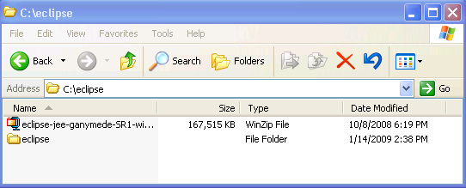
Installing and Configuring Eclipse
13
Eclipse 3.4 used in this course is an Accenture approved OSS. The License Agreement is found in the Appendix section of this module.
http://www.eclipse.org/ and download the Eclipse IDE.
The installer should be an archive file.
Extract the files in the archive to a directory of your choice (c:\eclipse in the example below).
Notes:
Key message:
The Eclipse that will be used is an Accenture approved OSS.
Eclipse license details can be found in the Appendix section of this module.
There might be different flavors of Eclipse available. For this course, the most appropriate download would be Eclipse IDE for Java EE developers or Eclipse IDE for Java Developers. The screenshots here were made using the Eclipse IDE for Java EE (Ganymede) release

Slide 14
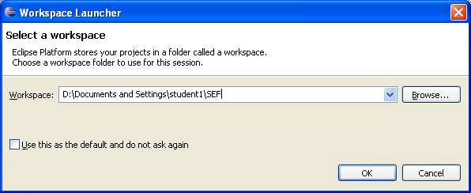
Installing and Configuring Eclipse
14
Once extracted, go to the directory, find the executable ‘eclipse.exe’ and create a shortcut to it.
Place the shortcut in a convenient location and double- click the shortcut to launch the Eclipse IDE.
After the splash screen, the IDE will prompt you to create a workspace. Name the workspace ‘SEF’.
Notes:
Key message:
The workspace is where all your projects and files will be stored. You can create several workspaces. Whenever you launch eclipse, the prompt will show up asking you wish workspace to use, or to create a new one if the specified directory doesn’t exist yet.

Slide 15
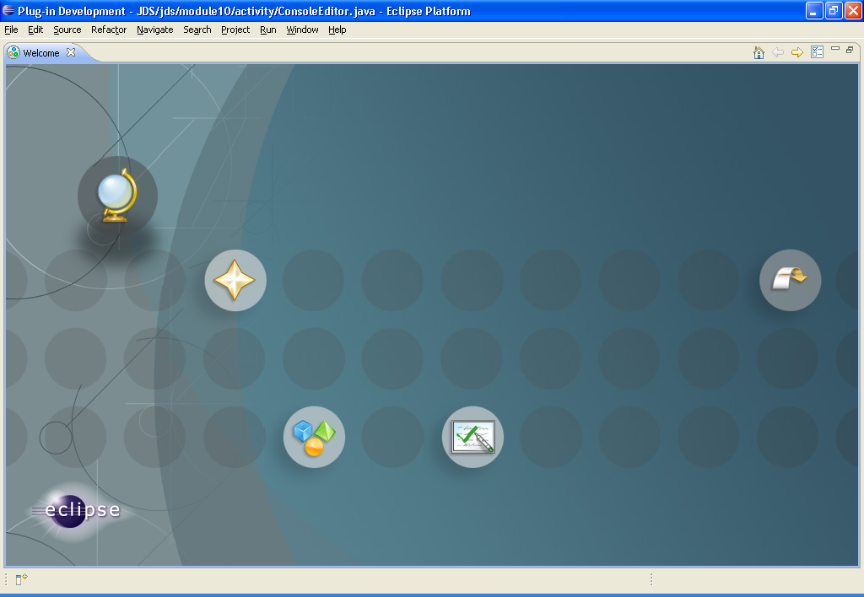
Installing and Configuring Eclipse
If it is your first time using eclipse, the ‘Welcome’ window should give you some first-timer options and tutorials.
Close the window for now. This can be accessed any time under the ‘Help->Welcome’ menu.
15
Notes:
Key message:
If you have time, you might want to try out the different samples and tutorials.

Slide 16
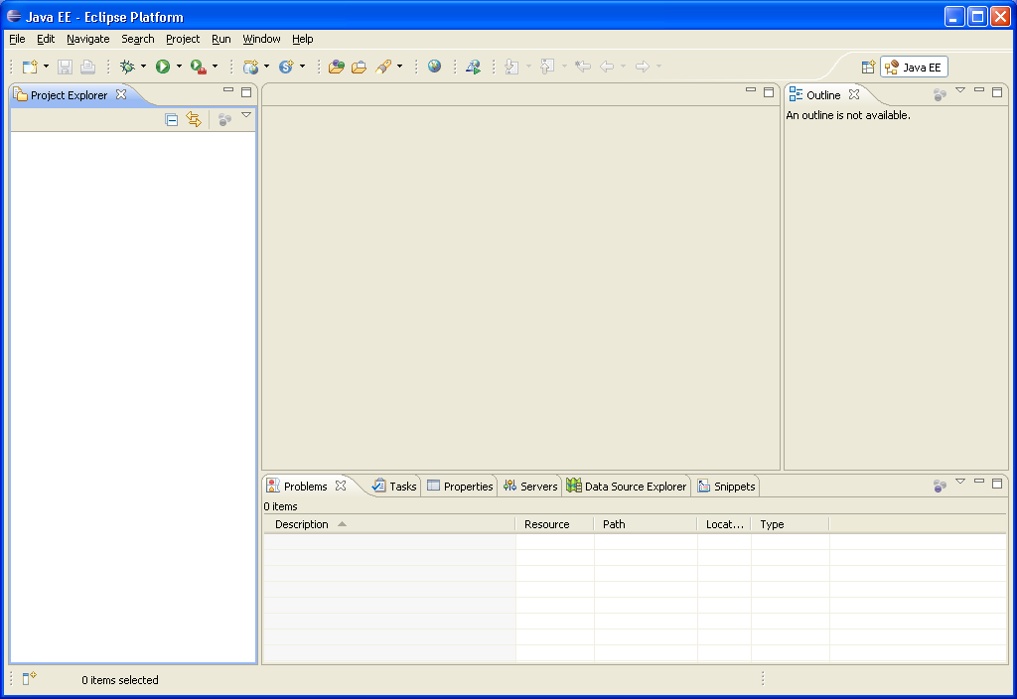
Installing and Configuring Eclipse
The editor window is where the selected component can be viewed and edited
The Project explorer allows you to browse the contents of the various projects you have created under the workspace
Information tabs at the bottom provide additional information about the application/component selected
The outline view allows you to look at the various elements of a component selected from the project explorer
16
Notes:
Key message:
All of the subsections of the workbench can be moved and resized.

Slide 17
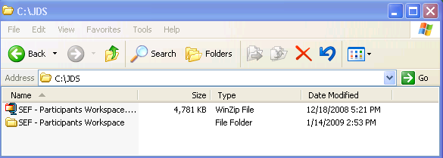
Installing and Configuring Eclipse
Extract the SEF – Participants Workspace to any directory you want.
In this example, the zip file is extracted to C:\JDS
17
Notes:
Key message:
All of the subsections of the workbench can be moved and resized.

Slide 18
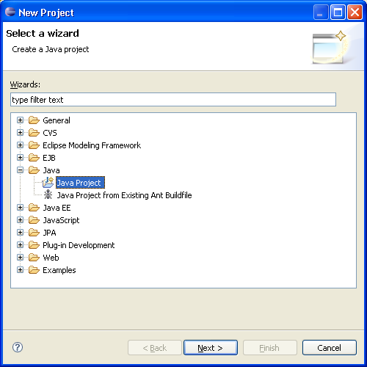
Installing and Configuring Eclipse
Create a new project by selecting File->New->Project
In the wizard, select Java Project
18
Notes:
Key message:
The kind of project chosen will dictate what kind of environment the workbench will configure itself to have. Since we’re only dealing with core Java applications, a basic Java Project will suffice.

Slide 19
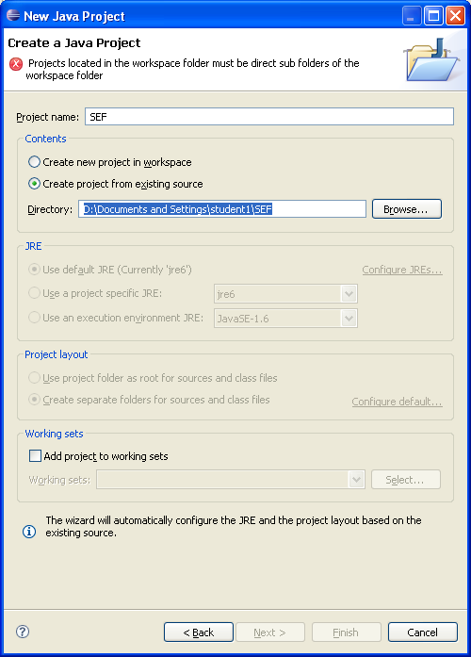
Installing and Configuring Eclipse
Use ‘SEF’ as the project name
Select ‘Create Project from an existing source’ and browse to the directory named SEF under the directory where the Eclipse SEF Participants Workspace archive is extracted
Click ‘Finish’ as we don’t need the other steps
19
Notes:
Key message:
You can create completely new projects from this page as well, without having to import from files. Just select ‘create new project’.
There is a selector for the JRE because its possible your machine will have different versions of JREs available. Of particular note is that pre 1.5 JREs have considerable syntax differences with more current JREs (1.5 and above).

Slide 20
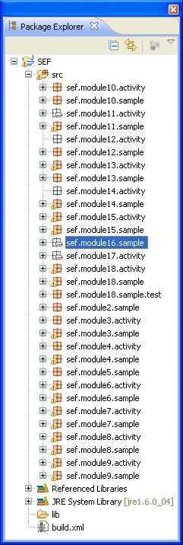
Installing and Configuring Eclipse
The work files for this training is divided into packages for each module
In the package explorer, go to sef.module2.sample and double click the file ‘HelloWorld.java’
The main editor view should show the contents of the HelloWorld.java file and the outline view should show the different elements of that file
20

Slide 21
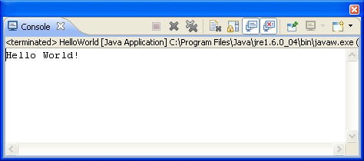
Installing and Configuring Eclipse
The HelloWorld file is a Java executable
Execute the file by right- clicking on the file->Run As->Java application
The console tab below the main editor should show the results of the application
21
Notes:
Eclipse auto compiles code whenever you save or make changes to them. Working with an IDE is preferable since it simplifies and automates many tasks. However, it is possible to compile and execute using the console.
In the JDK\bin directory of your java installation there should be a file called ‘javac’, which is the compiler. The basic syntax for use is:
Javac <source file>
Example: javac HelloWorld.java
To execute the application using the command line, look for the ‘java’ file in the same directory. The syntax is:
Java <class file>
Example: java HelloWorld
The .class files are needed when executing the file, not the .java file. Executing the sample above will tell the JVM to execute the byte code file ‘HelloWorld.class’.

Slide 22
What is a Java Class?
Classes are fundamental building blocks of a Java program.
The initial letter in the name of a class should be capitalized.
main() method in a class serves as a default entry point.
When a class is executed with the Java interpreter, the runtime system starts by calling the class's main() method.
22
Notes:
Notes To Instructor:
Mention to the participants that we will study classes and objects in detail in Modules 3 and 4. We have introduced concept of class at this point so that participants have some understanding of class before they work on the next activity which is to create a ‘sample’ class.

Slide 23
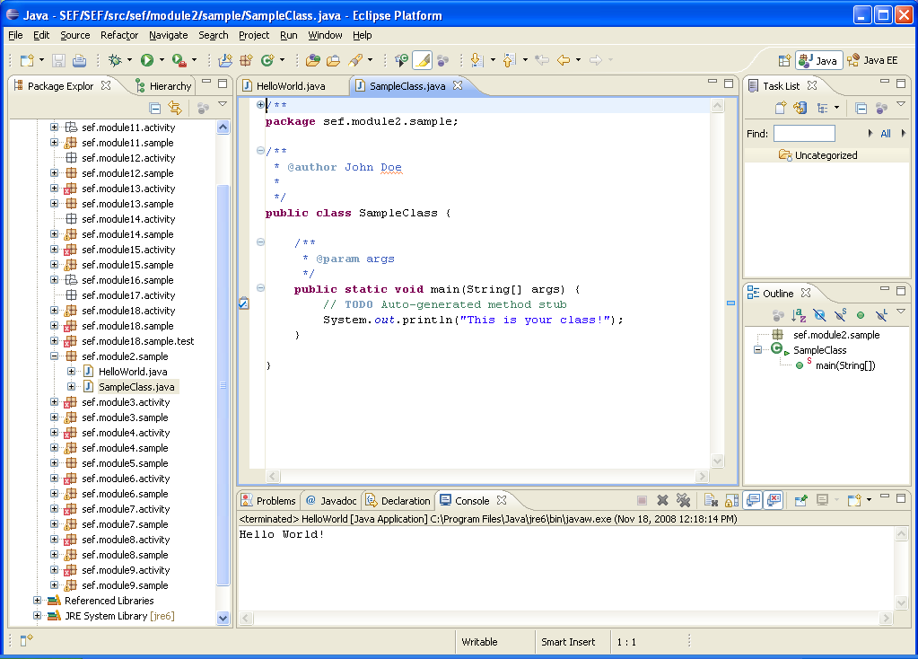
Create a new Java Class
Right-click on the package sef.module2.sample and select New->Class
Give the class a name ‘SampleClass’
Add ‘public static void main(String arg[]) in the method stubs
Click ‘Generate Comments’
Click Finish when done
23
Notes:
Notes to Instructor:
Instructors will show to the participants how to create a class in eclipse. Participants will then follow the steps and create the class in their own workspaces.
Eclipse auto compiles code whenever you save or make changes to them. Working with an IDE is preferable since it simplifies and automates many tasks. However, it is possible to compile and execute using the console.
In the JDK\bin directory of your java installation there should be a file called ‘javac’ which is the compiler. The basic syntax for use is
Javac <source file>
Example: javac HelloWorld.java
To execute the application using the command line, look for the ‘java’ file in the same directory. The syntax is
Java <class file>
Example java HelloWorld
The .class files are needed when executing the file, not the .java file. Executing the sample above will tell the JVM to execute the byte code file ‘HelloWorld.class’
Note: We will work on HelloWorld.java program in the next module.

Slide 24
Create a new Java Class
24
Complete the main method by typing:
public static void main(String[] args) {
// TODO Auto-generated method stub
System.out.println("This is your class!");
}
Compile and execute the new class and view the results!

Slide 25
Appendix
ECLIPSE
Version : 3.4
License : http://www.opensource.org/licenses/eclipse-1.0.php
JDK
Version : 1.6
License : http://java.sun.com/javase/6/jdk-6u10-license.txt

Slide 26

Questions and Comments
What questions or comments do you have?
26

